Slide 1
Entertainment Library
Karin Galicia Hernandez
CSC 460

Slide 2
Objective
Keep track of movies, books, or games you already own.
Avoid buying additional copies of movies, books, or games already in your collection.
Show additional information for every item in your library.
Ratings
Format (digital or physical)
Digital supplier (Apple TV, VUDU, Amazon Prime Video)

Slide 3

Books
Formats:
Paperback
Hardcover
eBook
Genre
Digital Supplier

Slide 4
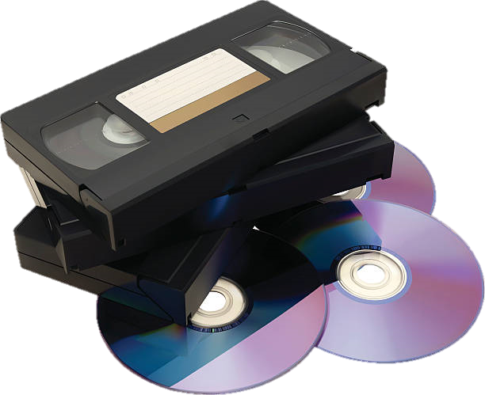
Movies
Formats:
VHS
DVD
Blu-ray
4k Blu-ray
Digital
Genre
Digital Supplier

Slide 5
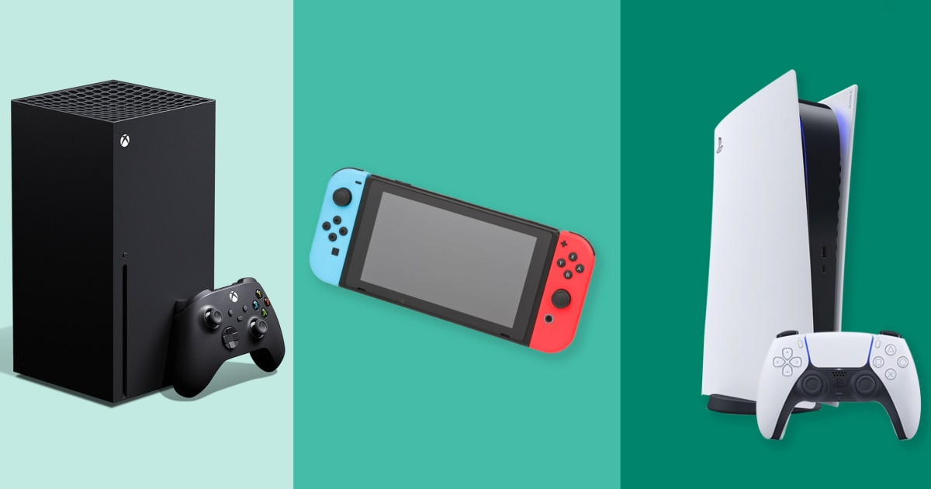
Videogames
Formats:
Disc
Cartridge
Digital
Platforms (Play Station, XBOX, Nintendo, Add your own)
Digital Supplier

Slide 6
Thank you

